Slide 1
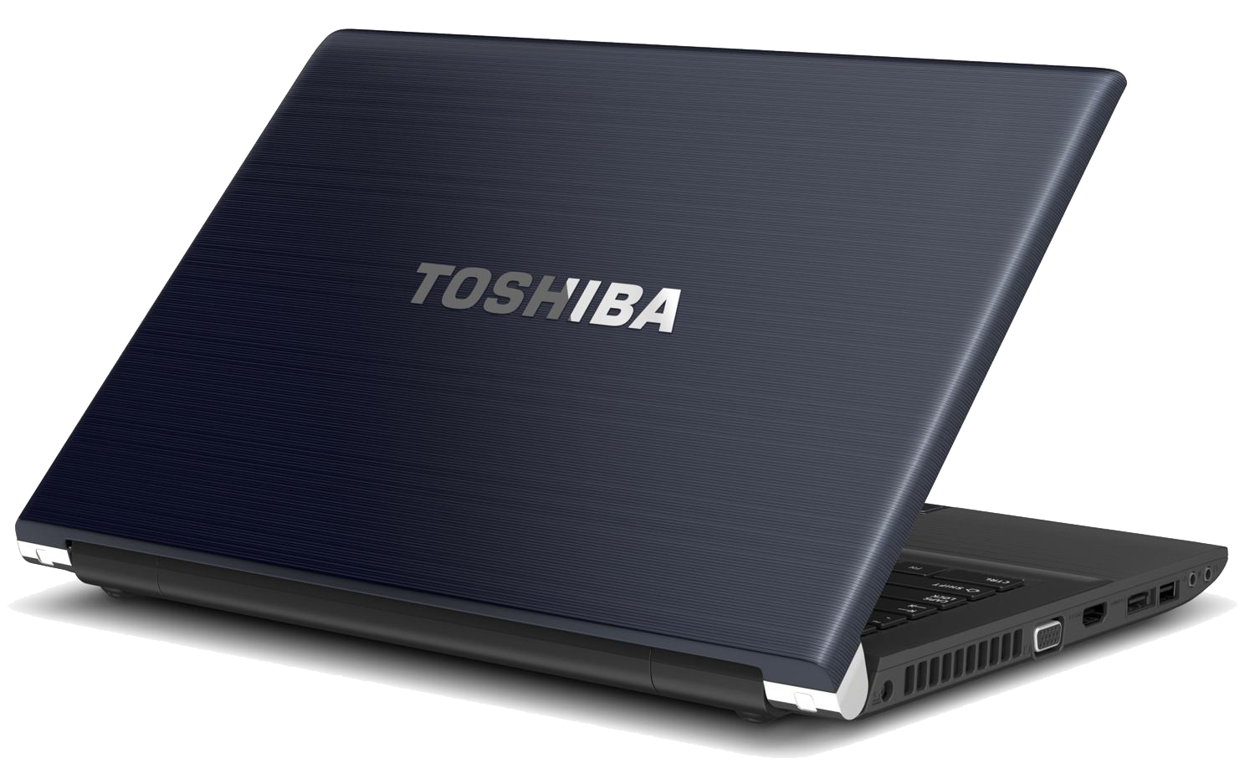
Password strength Checker
Name
Institution
Date

Slide 2
Password strength Checker
Password Strength checker is a system which is developed to provide passwords that are safe from password attackers through password pilfering.

Slide 3
Password strength Checker
Problem Definition
The password checker system aims at providing security and safety of the users passwords, the system only allows users to have passwords which are restricted to a certain length with combined special characters, the password should also include the numerical with both uppercase and lowercase letters

Slide 4
Password strength Checker
Significance of the project
One of the concerns that people often have when it comes to creating complex passwords is a fear of forgetting them, particularly when there are several to remember. Naturally, a person should try to think of something that will be easy for them to memorize. One way to do that is to turn a sentence or phrase into something that is not easily recognized by others.

Slide 5
Password strength Checker
Password Security Measures
passwords must be long and complex.
Long and complex passwords require more effort and time for a hacker to guess
Passwords should contain at least ten characters and have a combination of characters such as commas, percent signs, and parentheses, as well as upper-case and lower-case letters and numbers.
Users should never write down their passwords, as that makes it easier for the passwords to be stolen and used by someone else.
never use the same password for two or more devices, as hackers who break into one machine will try to use the same password to take control of others.

Slide 6
Password strength Checker
Objectives
To research and evaluate the password strength checkers that have been in use recently.
To enhance and make use of stronger passwords by users of the system.
To use a combination of special characters, combinations of uppercase and lowercase letters while generating the password

Slide 7
Password strength Checker
Checker Requirements
Computer
Operating system
Coding skills (Javascript,bootstrap,HTML and CSS
Data Structure Knowledge

Slide 8
Password strength Checker
References
[1] Dell'Amico M, Michiardi P, Roudier Y. Password strength: An empirical analysis. In2010 Proceedings IEEE INFOCOM 2010 Mar 14 (pp. 1-9). IEEE.
[2] Kelley PG, Komanduri S, Mazurek ML, Shay R, Vidas T, Bauer L, Christin N, Cranor LF, Lopez J. Guess again (and again and again): Measuring password strength by simulating password-cracking algorithms. In2012 IEEE symposium on security and privacy 2012 May 20 (pp. 523-537). IEEE.
[3] de Carné de Carnavalet X, Mannan M. From very weak to very strong: Analyzing password-strength meters. InNetwork and Distributed System Security Symposium (NDSS 2014) 2014. Internet Society.
[4] Bonneau J. Statistical metrics for individual password strength. InInternational Workshop on Security Protocols 2012 Apr 12 (pp. 76-86). Springer, Berlin, Heidelberg.

